Slide 1


Cell-free DNA (cfDNA) Blood-Based Testing for Colorectal Cancer
Sampada Pande
October 18, 2024

Slide 2
Agenda
01
02
03
04
Current Technology & Limitations
Statistics & Risk Factors
Proposed Technology
Introduction
05
06
07
08
Business Strategy
SWOT Analysis
Conclusion
References

Slide 3
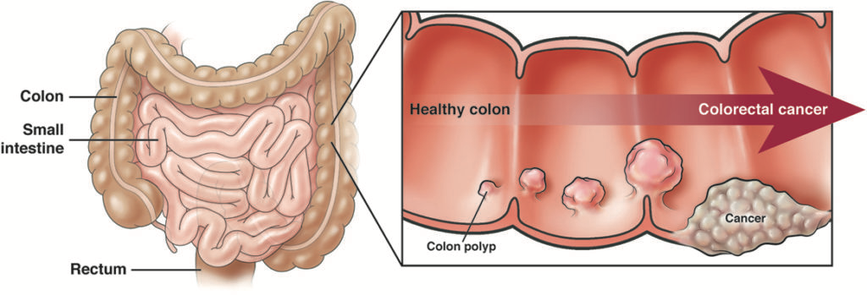
Introduction
Image of human intestine and polyps forming in colon and ultimately the rectum. (Stone, 2021)
Colorectal cancer (CRC) is a disease in which the cells of the colon transform into malignant tumors.
It is the third leading cause of death from cancer in the United States (National Cancer Institute, 2019).

Slide 4
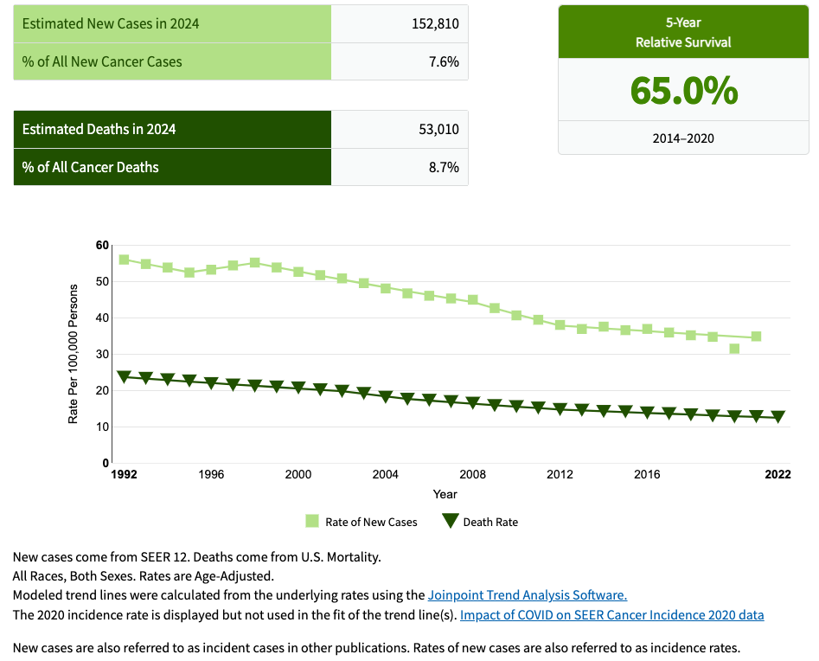
Statistics
Figure showing statistics for estimated new cases and deaths due to colorectal cancer in 2024 (National Cancer Institute, 2023).

Slide 5
Risk Factors
Older age
Inherited conditions (such as Lynch syndrome and familial adenomatous polyposis)
Family history of colorectal cancer
Excessive alcohol use
Obesity
Sedentary lifestyle
Cigarette smoking
Improper diet.
History of inflammatory bowel disease (such as ulcerative colitis or Crohn disease; (National Cancer Institute, 2021)
Colorectal cancer (CRC) is often diagnosed at a symptomatic, late stage.
Early detection can improve prognosis and treatment outcomes with timely intervention (Bhangu et al., 2017).

Slide 6
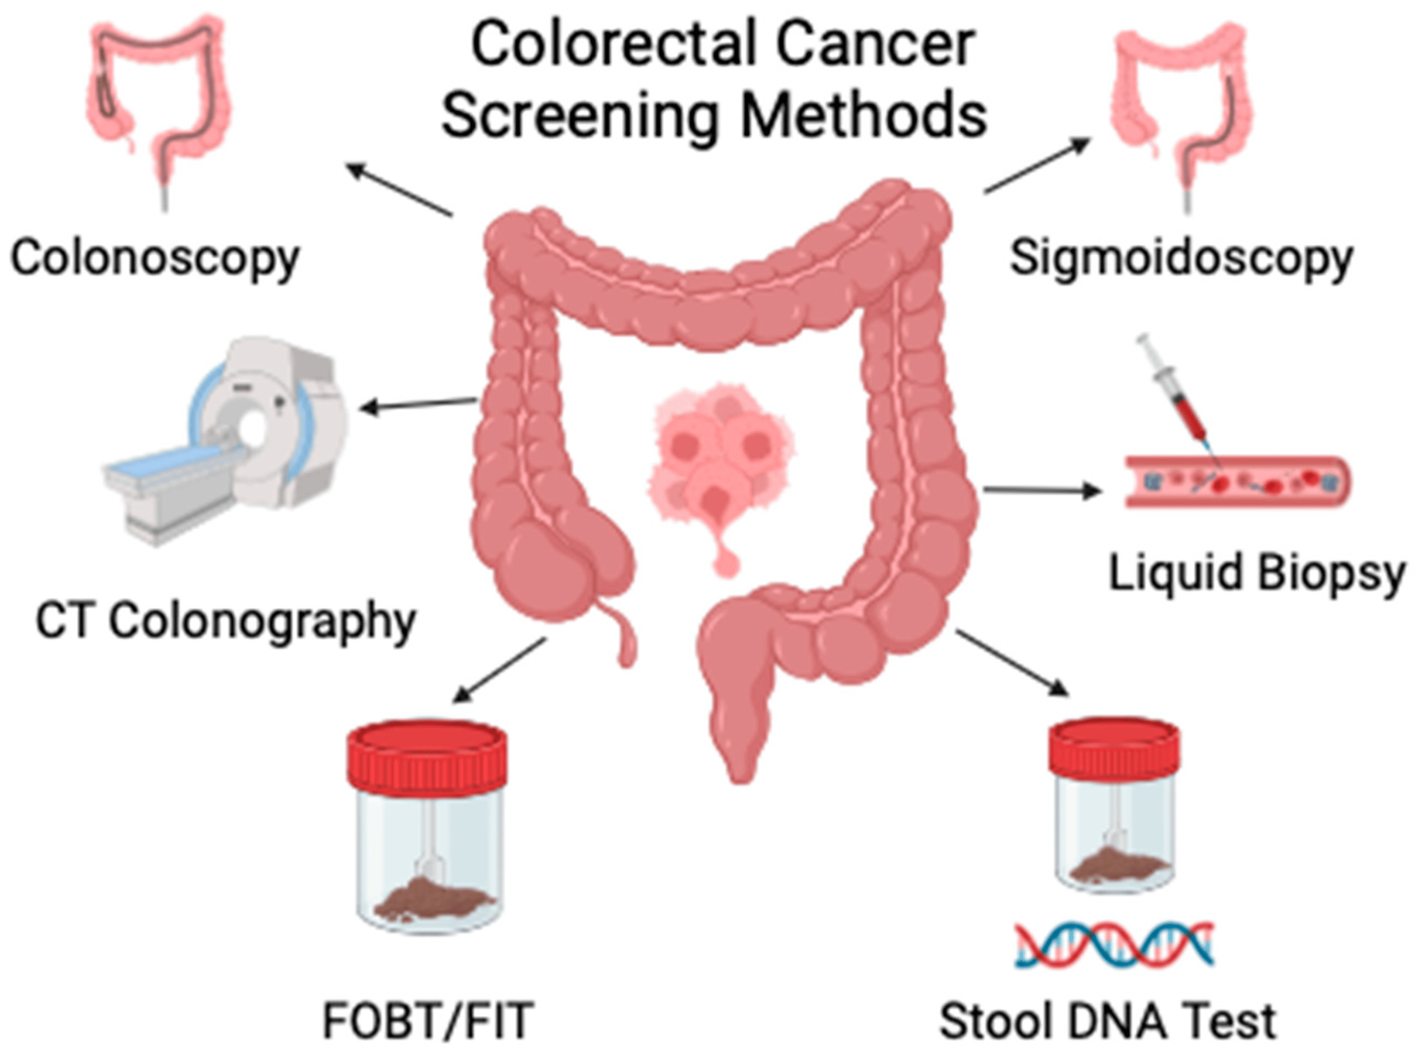
Current Screening Technology & Limitations
Colonoscopy-Invasive
Other tests-Poor sensitivity & specificity (Zhao et al., 2023)
Fear of the test
Lack of insurance coverage
Lack of physician recommendation for screening / awareness.
A blood-based test, performed as part of a routine healthcare tests will eliminate or alleviate a lot of the above problems (Chung et al., 2024).
Image of various screening methods for colorectal cancer (Maida et al., 2024)

Slide 7
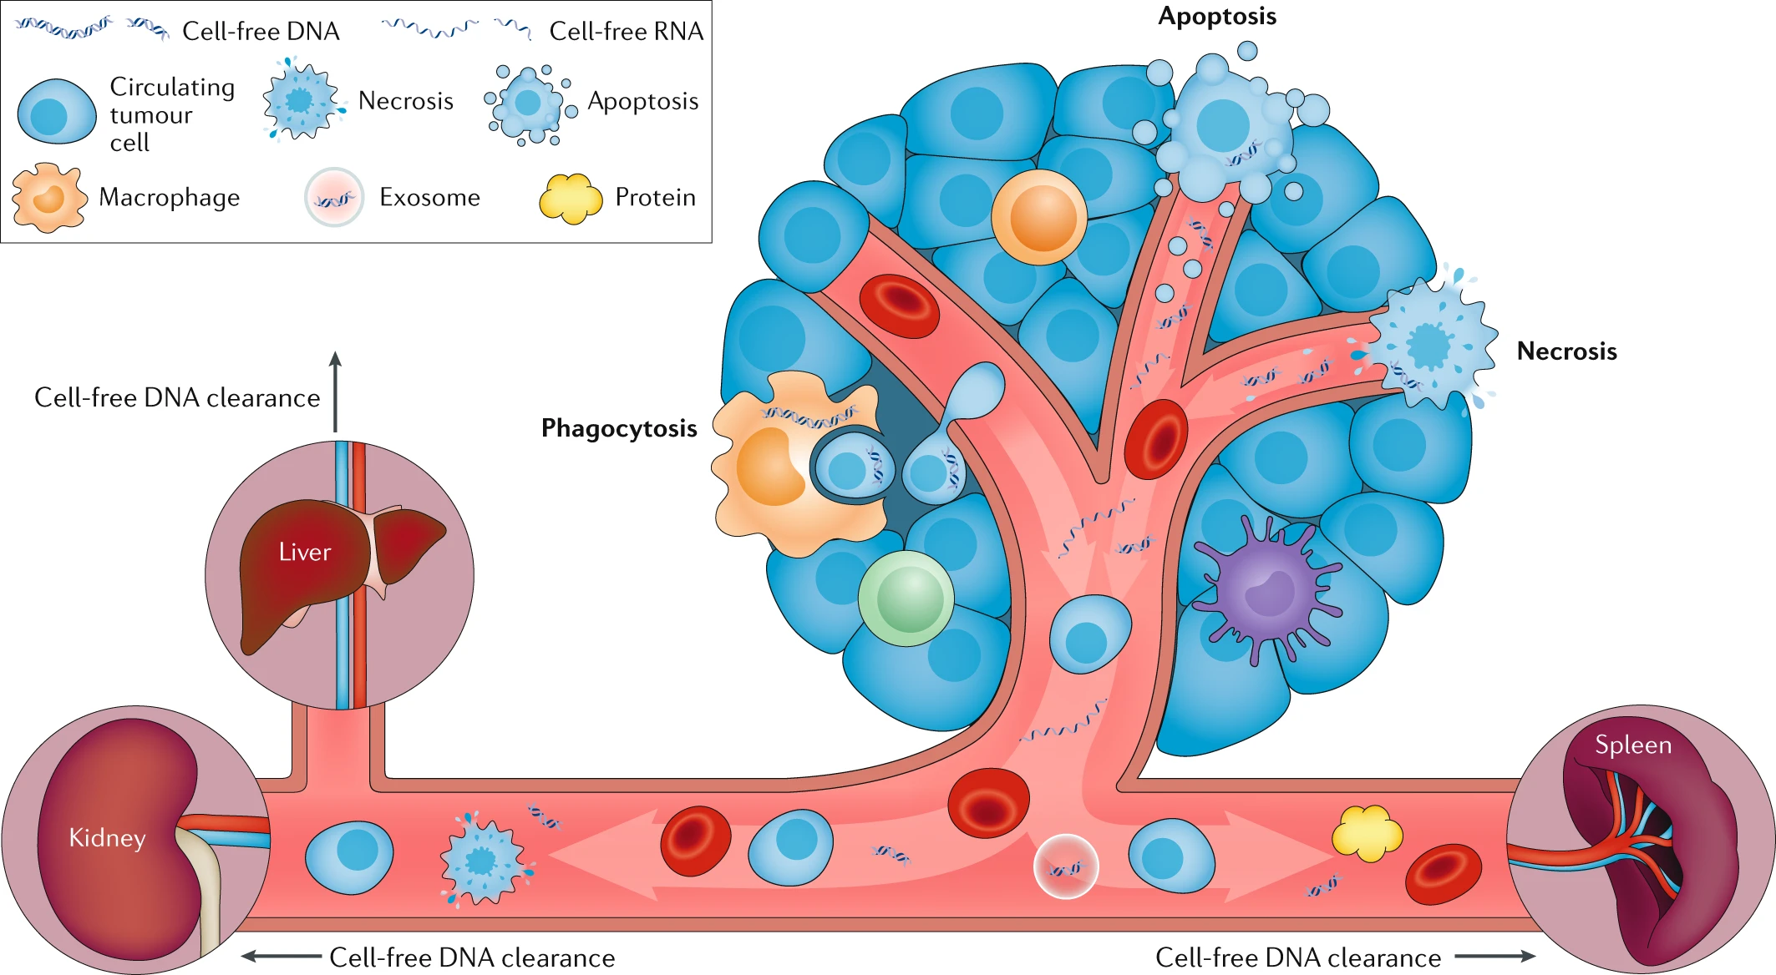
Proposed Technology
Cell-free DNA (cfDNA), are nucleic acid fragments that are released by cancer cells during apoptosis, necrosis, or secretion.
It reflects cancer-related genetic and epigenetic changes, including mutations, copy number alterations, chromosomal rearrangements, and abnormal methylation patterns (Gao et al., 2022).
Image of Circulating nucleic acid origins and clearance (Maia et al., 2020).

Slide 8
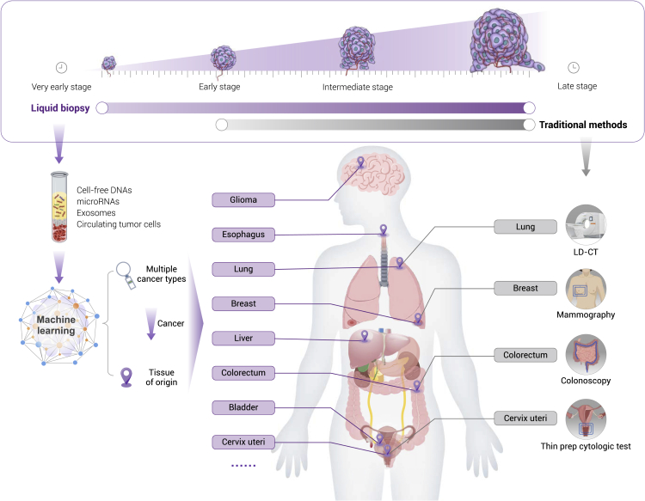
Proposed Technology
Liquid biopsy, known for its non- or minimally invasive nature, shows promise in detecting early-stage cancers and precancerous lesions by identifying circulating tumor cells, exosomes, cfDNA, mRNA, miRNAs, proteins, and metabolites (Gao et al., 2022).
Image depicting the comparison of liquid biopsy with traditional methods and its application in detecting various cancer (Gao et al., 2022).

Slide 9
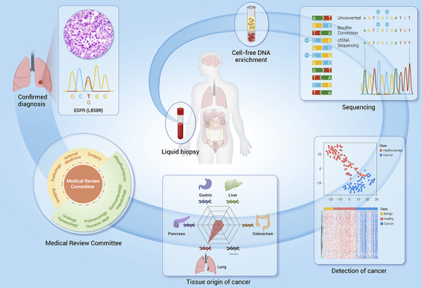
Proposed Technology
Whole blood samples collected
cfDNA extracted from blood plasma
Analysis using Next-generation sequencing (NGS)
Presence of CRC detected (if present)
Image depicting the process of CRC diagnosis using liquid biopsy (Gao et al., 2022).

Slide 10
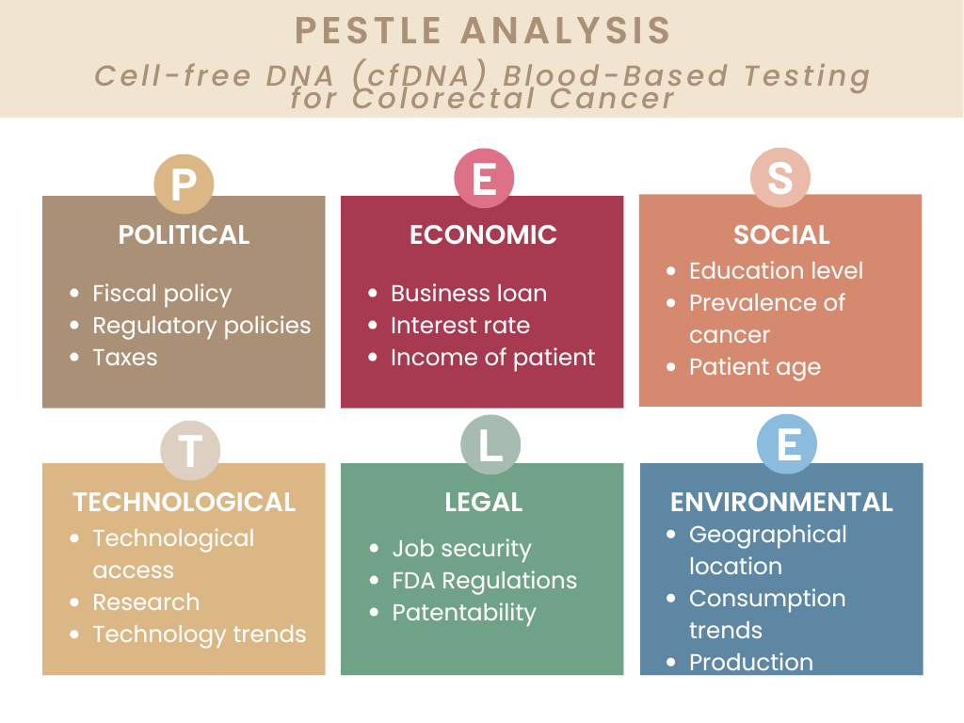
Business Strategy

Slide 11
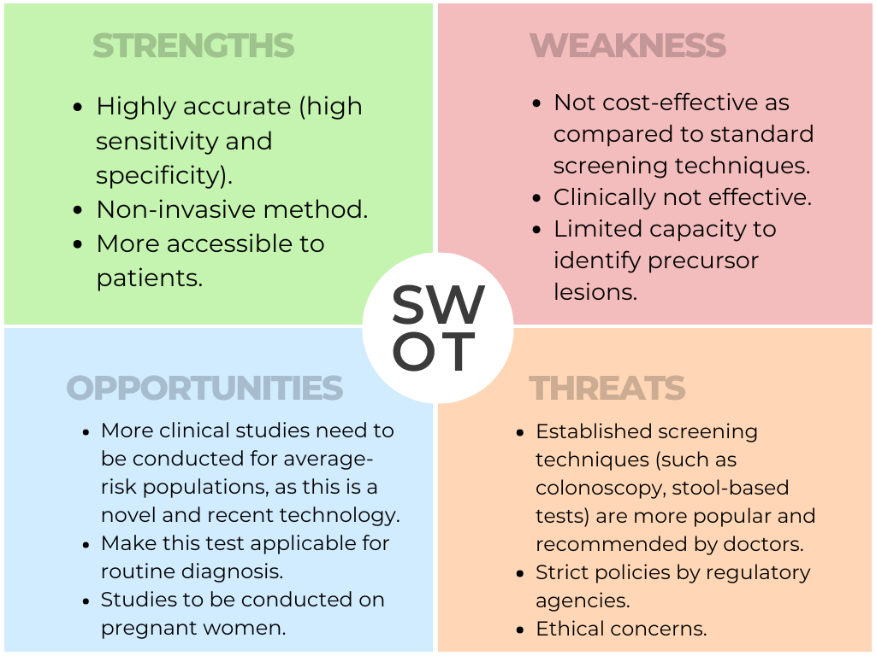
SWOT Analysis

Slide 12
Conclusion
Colorectal cancer continues to pose a significant health challenge, highlighting the urgent need for more effective and accessible screening solutions. cfDNA blood-based testing can thus be a viable technique in this regard.
While the market for advanced screening technologies is relatively nascent, this technology presents a unique opportunity to innovate and address this pressing problem.

Slide 13
References
American Cancer Society. (2024). Cancer Facts & Figures 2024. www.cancer.org. https://www.cancer.org/research/cancer-facts-statistics/all-cancer-facts-figures/2024-cancer-facts-figures.html
Bhangu, J. S., Taghizadeh, H., Braunschmid, T., Bachleitner-Hofmann, T., & Mannhalter, C. (2017). Circulating cell-free DNA in plasma of colorectal cancer patients - A potential biomarker for tumor burden. Surgical Oncology, 26(4), 395–401. https://doi.org/10.1016/j.suronc.2017.08.001
Chung, D. C., Gray, D. M., Singh, H., Issaka, R. B., Raymond, V. M., Eagle, C., Hu, S., Chudova, D. I., AmirAli Talasaz, Greenson, J. K., Sinicrope, F. A., Gupta, S., & Grady, W. M. (2024). A Cell-free DNA Blood-Based Test for Colorectal Cancer Screening. The New England Journal of Medicine, 390(11), 973–983. https://doi.org/10.1056/nejmoa2304714
Gao, Q., Zeng, Q., Wang, Z., Li, C., Xu, Y., Cui, P., Zhu, X., Lu, H., Wang, G., Cai, S., Wang, J., & Fan, J. (2022). Circulating cell-free DNA for cancer early detection. The Innovation, 3(4), 100259. https://doi.org/10.1016/j.xinn.2022.100259

Slide 14
References
Maia, M. C., Salgia, M., & Pal, S. K. (2020). Harnessing cell-free DNA: plasma circulating tumour DNA for liquid biopsy in genitourinary cancers. Nature Reviews Urology, 17(5), 271–291. https://doi.org/10.1038/s41585-020-0297-9
National Cancer Institute. (2019). Colorectal Cancer Prevention. National Cancer Institute; Cancer.gov. https://www.cancer.gov/types/colorectal/patient/colorectal-prevention-pdq
National Cancer Institute. (2021, August 2). Tests to Detect Colorectal Cancer and Polyps. National Cancer Institute; Cancer.gov. https://www.cancer.gov/types/colorectal/screening-fact-sheet
National Cancer Institute. (2023). Cancer of the Colon and Rectum - Cancer Stat Facts. SEER. https://seer.cancer.gov/statfacts/html/colorect.html
PROVIDER BROCHURE Colorectal Cancer Screening Test Intended Use / Indications for Use. (n.d.). Retrieved October 17, 2024, from https://shieldcancerscreen.com/wp-content/uploads/LBL-000351-R1-Shield-Provider-Labeling.pdf

Slide 15
References
Stone, C.-B. (2021, August 7). Colorectal cancer (CRC). AGA GI Patient Center. https://patient.gastro.org/colorectal-cancer-crc/
Zhao, F., Bai, P., Xu, J., Li, Z., Muhammad, S., Li, D., Zhang, Z., Gao, Y., & Liu, Q. (2023). Efficacy of cell-free DNA methylation-based blood test for colorectal cancer screening in high-risk population: a prospective cohort study. In Molecular Cancer (Vol. 22, Issue 1). BioMed Central Ltd. https://doi.org/10.1186/s12943-023-01866-z

Slide 16

THANK YOU!
spande3@jh.edu

